Slide 1



B-Trees and Red-Black Tree
Implementation and Operations
5
B-Trees
3
18
SoftUni Team
Technical Trainers
1
8
19
Software University
http://softuni.bg

Slide 2

Table of Contents
B-Trees
2-3 Trees
Ordered Operations
Insertion
Red-Black Tree
Insertion
Implementation

Slide 3
Have a Question?
sli.do #DsAlgo

Slide 4
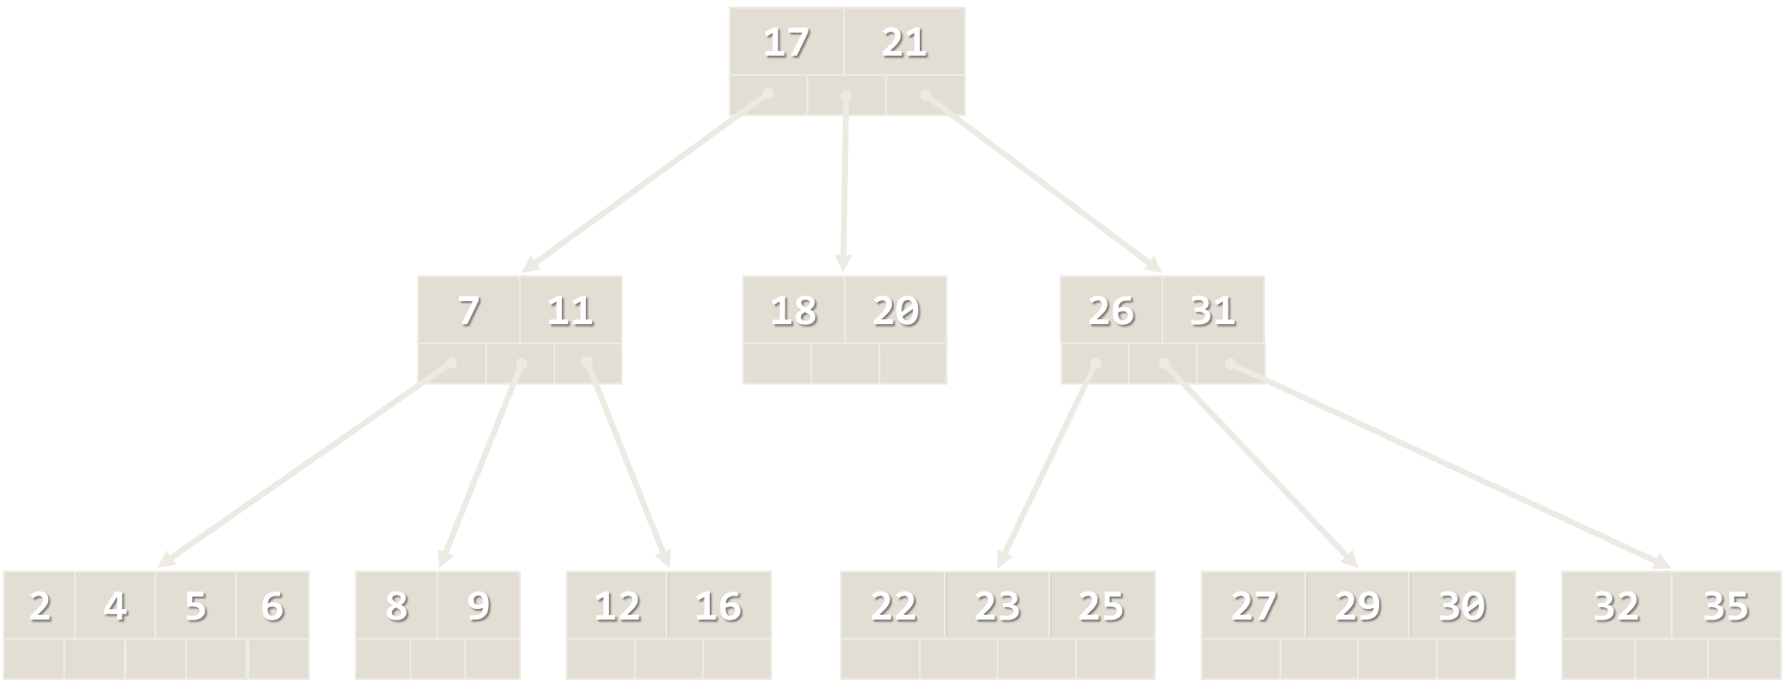
Balanced BSTs
Balancing a BST

Slide 5
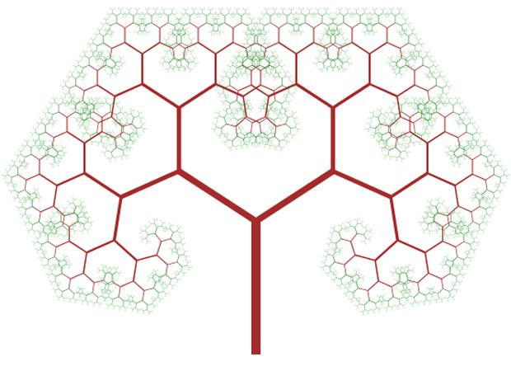
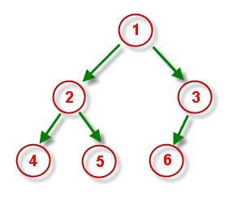
What is a Balanced Binary Search Tree?
Binary search trees can be balanced
Subtrees hold nearly equal number of nodes
Subtrees are with nearly the same height

Slide 6
Balanced Binary Search Tree – Example
The left subtree holds 7 nodes
33
The right subtree holds 6 nodes
The left subtree has height of 3
The right subtree has height of 3
18
54
15
24
42
60
3
17
20
29
37
43
85

Slide 7
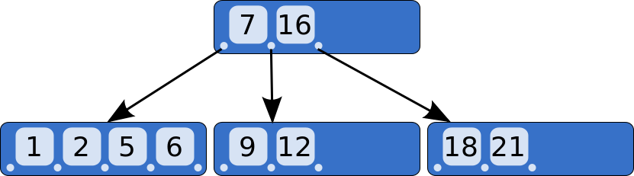
B-Trees
B-Trees Concept

Slide 8
What are B-Trees?
B-trees are generalization of the concept of ordered binary search trees – see the visualization
B-tree of order b has between b and 2*b keys in a node and between b+1 and 2*b+1 child nodes
The keys in each node are ordered increasingly
All keys in a child node have values between their left and right parent keys
B-trees can be efficiently stored on the hard disk

Slide 9
B-Tree – Example
B-Tree of order 3 (max count of child nodes), also known as 2-3 tree
13
7
11
41
3
5
9
12
32
50
73

Slide 10
B-Trees vs. Other Balanced Search Trees
B-Trees hold a range of child nodes, not single one
B-trees do not need re-balancing so frequently
B-Trees are good for database indexes
Because a single node is stored in a single cluster of the hard drive
Minimize the number of disk operations (which are very slow)
B-Trees are almost perfectly balanced
The count of nodes from the root to any null node is the same

Slide 11
2-3 Trees
13
7
11
41
3
5
9
50
73
2-3 Trees Operations

Slide 12
Definition
A 2-3 search tree can contain:
Empty node (null)
2-node with 1 key and 2 links (children)
3-node with 2 keys and 3 links (children)
As usual for BSTs, all items to the left are smaller, all items to the right are larger.

Slide 13
2-3 Tree Example
3-node with 2 keys and 3 links
13
2-node with 1 key and 2 links
Smaller than 7
7
11
41
Larger than 11
3
5
9
12
32
50
73
Larger than 7, smaller than 11

Slide 14
2-3 Tree Searching
Searching for 12
Identical to BST Search
13
7
11
41
3
5
9
12
32
50
73

Slide 15
2-3 Tree Insertion (at 2-node)
Becomes a 3-node
13
30

Slide 16
2-3 Tree Insertion (at 3-node)
Temporary
4-node
13
30
50

Slide 17
2-3 Tree Insertion
Into a 3-node whose parent is a 2-node
9
9
Insert 40
31
52
31
40
52
9
40
31
52

Slide 18
2-3 Tree Insertion (2)
Into a 3-node whose parent is a 3-node
30
50
30
50
Insert 25
10
20
10
20
25
30
20
30
50
20
50
10
25
10
25

Slide 19
2-3 Tree Construction
Insert 50
50

Slide 20
2-3 Tree Construction (2)
Insert 30
30
50

Slide 21
2-3 Tree Construction (3)
Insert 35
30
35
50
35
30
50

Slide 22
2-3 Tree Construction (4)
Insert 20
35
20
30
50

Slide 23
2-3 Tree Construction (5)
Insert 10
35
10
20
30
50
20
35
10
30
50

Slide 24
2-3 Tree Construction (6)
Insert 70
20
35
10
30
50
70

Slide 25
2-3 Tree Construction (7)
Insert 33
20
35
10
30
33
50
70

Slide 26
2-3 Tree Construction (8)
Insert 40
20
35
10
30
33
40
50
70
20
35
50
10
30
33
40
70

Slide 27
2-3 Tree Construction (9)
35
20
50
10
30
33
40
70

Slide 28
2-3 Tree Properties
Unlike standard BSTs, 2-3 trees grow from the bottom
The number of links from the root to any null node is the same
Transformations are local
Nearly perfectly balanced
Inserting 10 nodes will result with height of the tree 2
For normal BSTs the height can be 9 in the worst case

Slide 29
2-3 Tree - Quiz
TIME’S UP!
TIME:
Suppose that you are inserting a new node to a 2-3 tree. Under which of the following scenarios must the height of the 2-3 tree increase by one?
Number of nodes is equal to power of 2
Number of nodes is one less than a power of 2
When the final node on a search path from the root is a 3-node
When every node on the search path from the root is a 3-node

Slide 30
2-3 Tree - Answer
TIME’S UP!
TIME:
Suppose that you are inserting a new node to a 2-3 tree. Under which of the following scenarios must the height of the 2-3 tree increase by one?
Number of nodes is equal to power of 2
Number of nodes is one less than a power of 2
When the final node on a search path from the root is a 3-node
When every node on the search path from the root is a 3-node

Slide 31
2-3 Tree - Summary
Structure | Worst case |  |  | Average case
 | Search | Insert | Delete | Search Hit | Insert
BST | N | N | N | 1.39 lg N | 1.39 lg N
2-3 Tree | c lg N | c lg N | c lg N | c lg N | c lg N
Constants depend on implementation

Slide 32
2-3 Tree - Exercises
Draw the 2-3 tree that results when you insert the keys { E A S Y Q U T I O N } in that order into an initially empty tree
Draw the 2-3 tree that results when you insert the keys { Y L P M X H C R A E S } in that order into an initially empty tree
Find an insertion order for the keys { S E A R C H X M } that leads to a 2-3 tree of height 1.

Slide 33
Red-Black Tree
13
11
41
7
73
5
9
50
3
Simple Representation of a 2-3 Tree

Slide 34
Representing 3-Nodes from 2-3 Tree
We will represent 3-nodes with a left-leaning red nodes
Nodes with values between the 2 nodes will be to the right of the red node
30
20
30
20

Slide 35
Red-Black Tree Properties
All leaves are black
The root is black
No node has two red links connected to it
Every path from a given node to its descendant leaf nodes contains the same number of black nodes
Red links lean left

Slide 36

Rebalancing Trees
Rotations

Slide 37
Rotations
Rotations are used to correct the balance of a tree
Balance can be measured in height, depth, size etc. of subtrees
17
Right subtree weights more
25
9

Slide 38
Left Rotation
Orient a right-leaning red link to lean left
In Order Preserved
y
x
Left rotation (y)
x
y

Slide 39
Right Rotation
Orient a left-leaning red link to lean right (temporarily)
In Order Preserved
x
y
Right rotation (x)
y
x

Slide 40
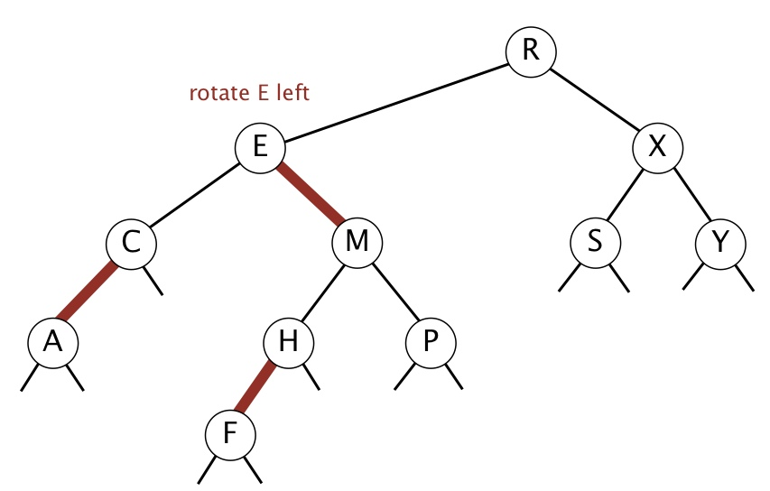
Rotations - Quiz
R E X C M S Y A H P F
R M X E H S Y C F P A
R M X E P S Y C H A F
R C X A E S Y M H P F

Slide 41
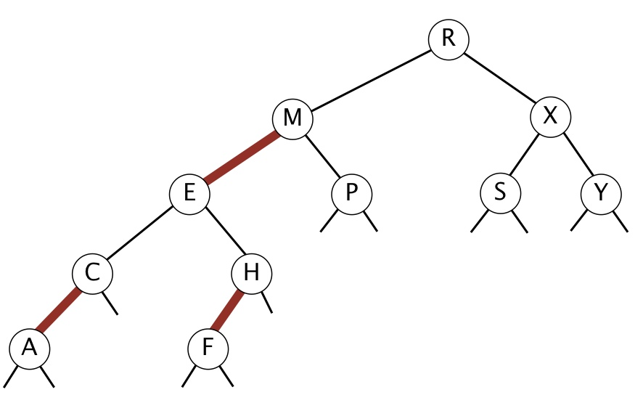
Rotations - Answer
R E X C M S Y A H P F
R M X E H S Y C F P A
R M X E P S Y C H A F
R C X A E S Y M H P F

Slide 42
Red-Black Tree
13
11
41
7
73
5
9
50
3
Insertion

Slide 43
Insertion Algorithm
Locate the node position
Create new red node
Add the new node to the tree
Balance the tree if needed

Slide 44
Insertion
Larger element
Insert into a single 2-node:
Smaller element
The red node is leaning right, we need left rotation
73
73
80
50
80
The red node is leaning left
73

Slide 45
Insertion (2)
Insert smaller item into a 2-node at the bottom:
13
11
41
The red node is leaning left
7
73
5
9
50

Slide 46
Insertion (3)
Insert larger item into a 2-node at the bottom:
13
13
11
41
11
41
7
73
7
80
5
9
80
5
9
73
The red node is leaning right
Left rotation

Slide 47
Insertion Into 3-Node
3 cases:
The element is smaller than both keys
The element is larger than both keys
The element is between the 2 keys

Slide 48
Insertion Into 3-Node (2)
Larger than both keys:
Flipping the colors increases the tree height, which maintains the 1-1 correspondence to 2-3 trees
Flip the colors
13
13
11
41
11
41

Slide 49
Insertion Into 3-Node (3)
Smaller than both keys:
13
Left-Heavy tree, needs right rotation
11
11
9
13
9
11
9
13
Flip the colors

Slide 50
Insertion Into 3-Node (4)
Between the keys:
30
50
Right-Leaning red link - Left Rotation
20
50
20
30
50
30
30
20
50
20

Slide 51
Flipping Colors
Flipping the colors should also change the parent color to red
Preserves perfect black balance in the tree!
void FlipColors(Node node)
{
node.Color = Red;
node.Left.Color = Black;
node.Right.Color = Black;
}

Slide 52
Keeping Black Root
Insert on a single node (root):
Each time the root switches colors, the height of the tree is increased
30
30
30
20
50
20
50
20
50

Slide 53
Insert Into 3-Node at the Bottom
Insert 8
5
5
3
19
3
18
1
18
1
8
19
5
8
3
18
1
8
19

Slide 54
Insert Into 3-Node at the Bottom (2)
18
5
5
19
3
18
3
8
1
8
19
1

Slide 55
Overall Insertion Process
Left
Rotate
Right Rotate
Flip
Colors

Slide 56
Red-Black Tree
5
3
18
1
8
19
Insertion Implementation

Slide 57
Changes to the BST Class
class RedBlackTree<T>
{
private const bool Red = true;
private const bool Black = false;
private class Node
{
public Node(T value, bool color) // Constructor public bool Color { get; set; }
// Other properties
}
}

Slide 58
Changes to the BST Class (2)
class RedBlackTree<T>
{
private bool IsRed(Node node)
private Node RotateLeft(Node node)
private Node RotateRight(Node node)
private void FlipColors(Node node)
}

Slide 59
Rotate Right
private Node RotateRight(Node node)
{
Node temp = node.Left;
node.Left = temp.Right;
temp.Right = node;
temp.Color = node.Color;
node.Color = Red;
temp.Count = node.Count;
node.Count = 1 + Count(node.Left) + Count(node.Right);
return temp;
}

Slide 60
Rotate Left
private Node RotateLeft(Node node)
{
Node temp = node.Right;
node.Right = temp.Left;
temp.Left = node;
// Same operations as RotateRight()
return temp;
}

Slide 61
Insert
private bool IsRed(Node node)
{
if (node == null) return false;
return node.Color == Red;
}
public void Insert(T element)
{
this.root = this.Insert(element, this.root);
this.root.Color = Black;
}

Slide 62
Insert(2)
private Node Insert(T element, Node node) {
if (node == null) node = new Node(element, Red);
// Recursive calls
if (this.IsRed(node.Right) && !this.IsRed(node.Left))
node = this.RotateLeft(node);
if (this.IsRed(node.Left) && this.IsRed(node.Left.Left))
node = this.RotateRight(node);
if (this.IsRed(node.Left) && this.IsRed(node.Right))
this.FlipColors(node);
// Increase count
}

Slide 63

Lab Exercise
Red-Black Tree - Insertion

Slide 64
Red-Black Tree - Quiz
TIME’S UP!
TIME:
Suppose that you insert n keys in ascending order into a red-black BST. What is the height of the resulting tree?
Constant
Logarithmic
Linear
Linearithmic

Slide 65

Red-Black Tree - Answer
Suppose that you insert n keys in ascending order into a red-black BST. What is the height of the resulting tree?
Constant
Logarithmic
Linear
Linearithmic
The height of any red–black BST on n keys (regardless of the order of insertion) is guaranteed to be between log₂n and 2log₂n

Slide 66
Red-Black Tree - Summary
Structure | Worst case |  |  | Average case
 | Search | Insert | Delete | Search Hit | Insert
BST | N | N | N | 1.39 lg N | 1.39 lg N
2-3 Tree | c lg N | c lg N | c lg N | c lg N | c lg N
Red-Black | 2 lg N | 2 lg N | 2 lg N | lg N | lg N

Slide 67

Summary
B-Trees can be efficiently stored on the hard disk
2-3 tree is B-Tree of order 3
Not perfectly balanced
Performs local transformations
Red-Black tree is a simple representation of a 2-3 tree
Performs local rotations

Slide 68







B-Trees and Red-Black Trees
https://softuni.bg/opencourses/data-structures

Slide 69
License
This course (slides, examples, labs, videos, homework, etc.) is licensed under the "Creative Commons Attribution-NonCommercial-ShareAlike 4.0 International" license
Attribution: this work may contain portions from
"Fundamentals of Computer Programming with C#" book by Svetlin Nakov & Co. under CC-BY-SA license
"Data Structures and Algorithms" course by Telerik Academy under CC-BY-NC-SA license

Slide 70





Trainings @ Software University (SoftUni)
Software University – High-Quality Education, Profession and Job for Software Developers
softuni.bg
Software University Foundation
softuni.org
Software University @ Facebook
facebook.com/SoftwareUniversity
Software University Forums
forum.softuni.bg

